Slide 1
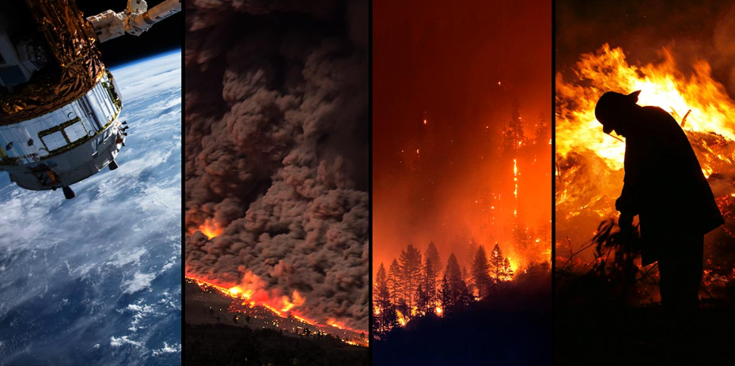
Natural Disaster
Geospatial
Damage Assessment
Team Disaster
DAEN 690 Project
Spring 2020
Sponsor: Accenture Federal Services

Slide 2
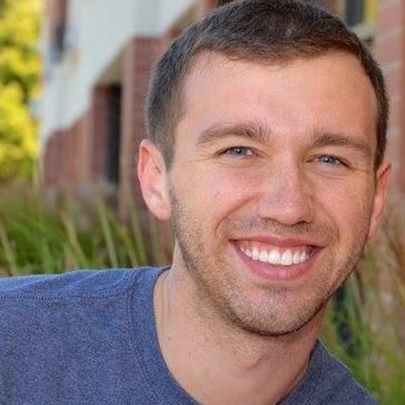



Team Members
Billy Ermlick Nick Newman Devayani Pawar Tyler Richardett
(Product Owner) (Scrum Master)
Accenture Federal Services:
Marc Ruiz Bosch & Christian Conroy

Slide 3

Problem Definition
Relief efforts rely on damage assessments for identifying target areas, extent of damage, and required funding
Typically a slow and dangerous “on-the-ground” assessment is performed
Need a way to assess damage in a fast, accurate, and safe way
[1]
FEMA conventional damage assessments

Slide 4
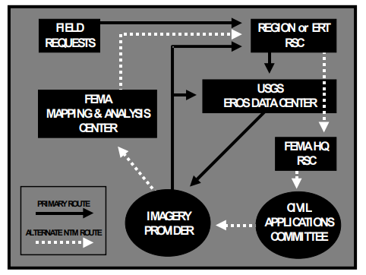
Problem Definition
Satellite images provide fast information regarding damaged areas
FEMA and others currently manually review images for building damage
Provide assessments according to the United States National Grid
Need to automate this review process
FEMA remote sensing procedure
[2]

Slide 5
Project Definition
Objective
Create a proof-of-concept application which uses satellite images to automatically estimate building damage and visualize cost according to the United States National Grid coordinate system.

Slide 6
Agenda
Datasets
Financial Modeling
USNG Mapping
Financial Model & Visualization
Damage Estimate Modeling
U-net Architecture
Mask-RCNN
Application
Notes:
now that the problem is defined…

Slide 7
Datasets
Xview2

Slide 8
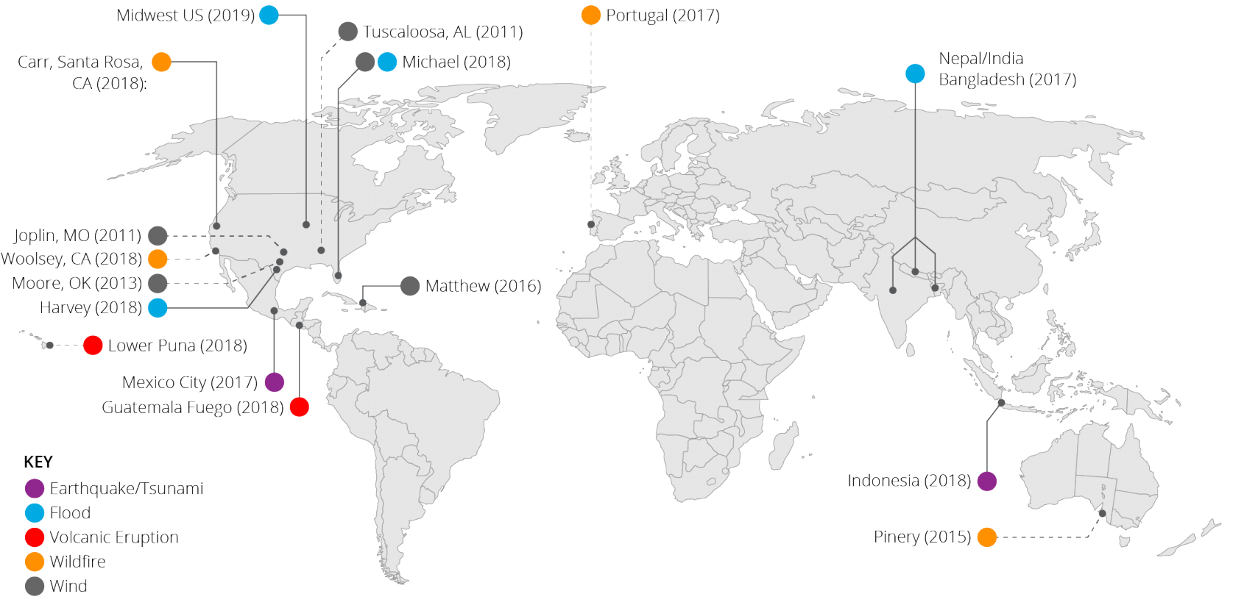
Xview2 Dataset
Overview
Defense Innovation Unit & Maxar open competition ended January 2020
Public dataset
Images of 850k buildings before and after disasters from around the world from 2011-2018
Disaster events and locations
[3]

Slide 9
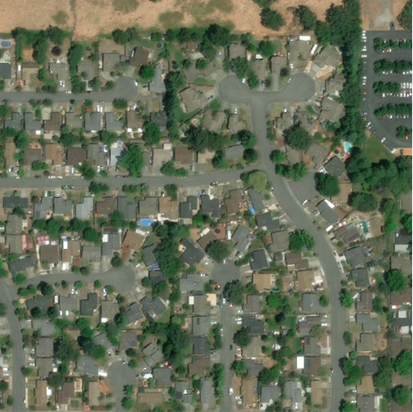
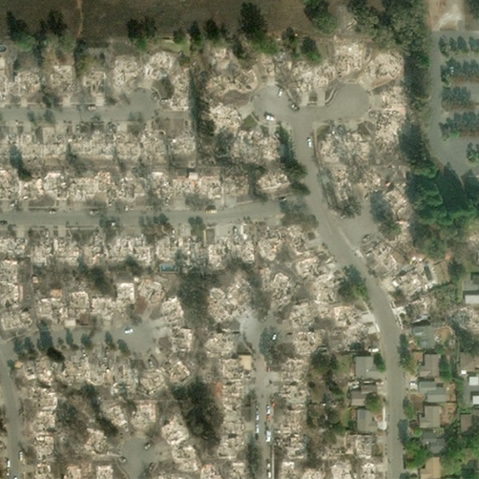
Xview2 Dataset
Overview
6 types of disasters (hurricanes, wildfires, floods, earthquakes, etc.)
Images of same location before/after disaster (nadir angles may vary)
Pre and post disaster image
[3]

Slide 10
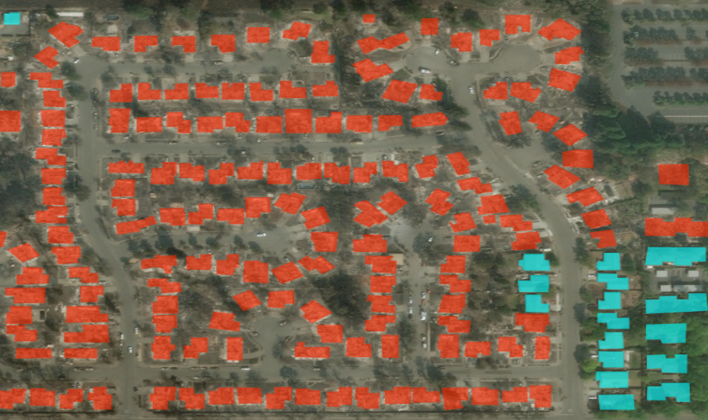
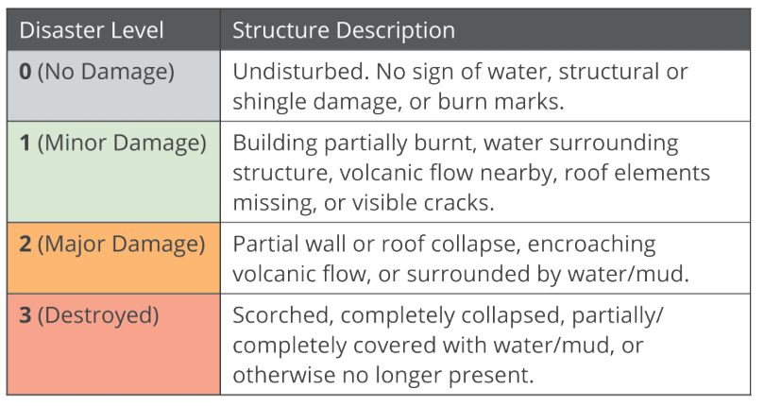
Xview2 Dataset
Annotations
Unified labels for building locations and standardized damage level (0-4)
Panel reviewed for consistency
[3]
Annotated post-disaster image
Notes:
To establish a common standard, we present the Joint Damage Scale (JDS), a unified assessment scale for building damage in satellite imagery across multiple hazard types, structure categories, and geographical locations. The JDS is based mainly on HAZUS, FEMA's Damage Assessment Operations Manual, the Kelman scale, and the EMS-98. Literature from the GIS community and expert insights from the California Air National Guard, the Indiana Air National Guard and the U.S. Air Force ensure the scale is operationally relevant.

Slide 11
Xview2 Dataset
Predictions & Evaluation
Output two PNG image with pixel values representing
building locations (0/1)
damage level (0-4)
Final f1 score is evaluated based on 30% location and 70% damage f1 values
[3]
Annotated post-disaster image

Slide 12
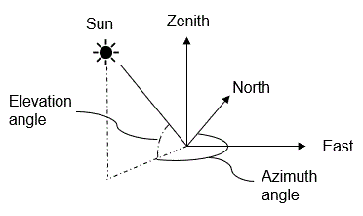
Xview2 Dataset
Field Descriptions
Attribute | Type | Description
Image ID | STR | Unique ID identifying each image
Disaster ID | STR | Unique ID identifying each disaster
Image Name | STR | Pre/post and which disaster
Capture Date | Date | Date the image was captured
Height/Width | INT | All images are of size: (1024, 1024, 3)
Ground Sampling Distance | Float | Distance between pixel centers on the ground
Off_Nadir_Angle | Float | Image capture angle relative to ground plane
Pan_Resolution | Float | Resolution of single band image used for pan sharpening
Sun_Azimuth | Float | Angle of the sun from polar north
Sun_Elevation | Float | Angle of the sun from ground plane
Target Azimuth | Float | Angle of satellite from polar north
Provider_Asset_Type | STR | Satellite model image taken from
LAT/LON Polygon | Poly | Polygon lat/lon coordinates of each building
Damage-Classification | INT | Indication of level of damage for each building
[4]
Sun azimuth and elevation angle
Notes:
relevant data. dont need to touch on all jsut the last two are important -- image is used to explain nadir angle if they don’t get it

Slide 13
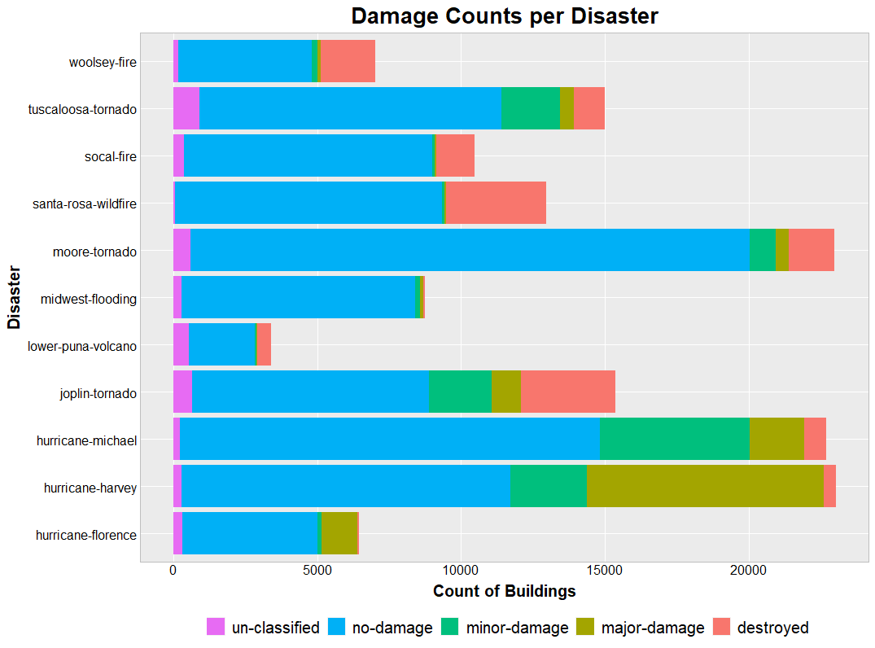
Xview2 Dataset
Data Condition:
Clean dataset
No missing or incorrect values
Buildings obsecured or newly built in an “after” image not counted
Imbalanced by
disaster type
class - mainly un-damaged

Slide 14
Other Public Datasets
Zillow 2018 $/sqft:
Dataset providing $/sqft for US zip codes
Average cost used for missing zipcodes
US GeoID, County Tract, & Zipcode listings:
Utilized to map building lat/lons to geoID -> countytract -> zipcode
API & CSV files provided by US Census Bureau
NOAA Disaster Cost Evaluation Data:
Ballpark cost of property damage for a few disasters by county
Notes:
all public data sources - National Oceanic and Atmosphereic adminsitration

Slide 15
Financial Modeling
USNG Mapping Function

Slide 16
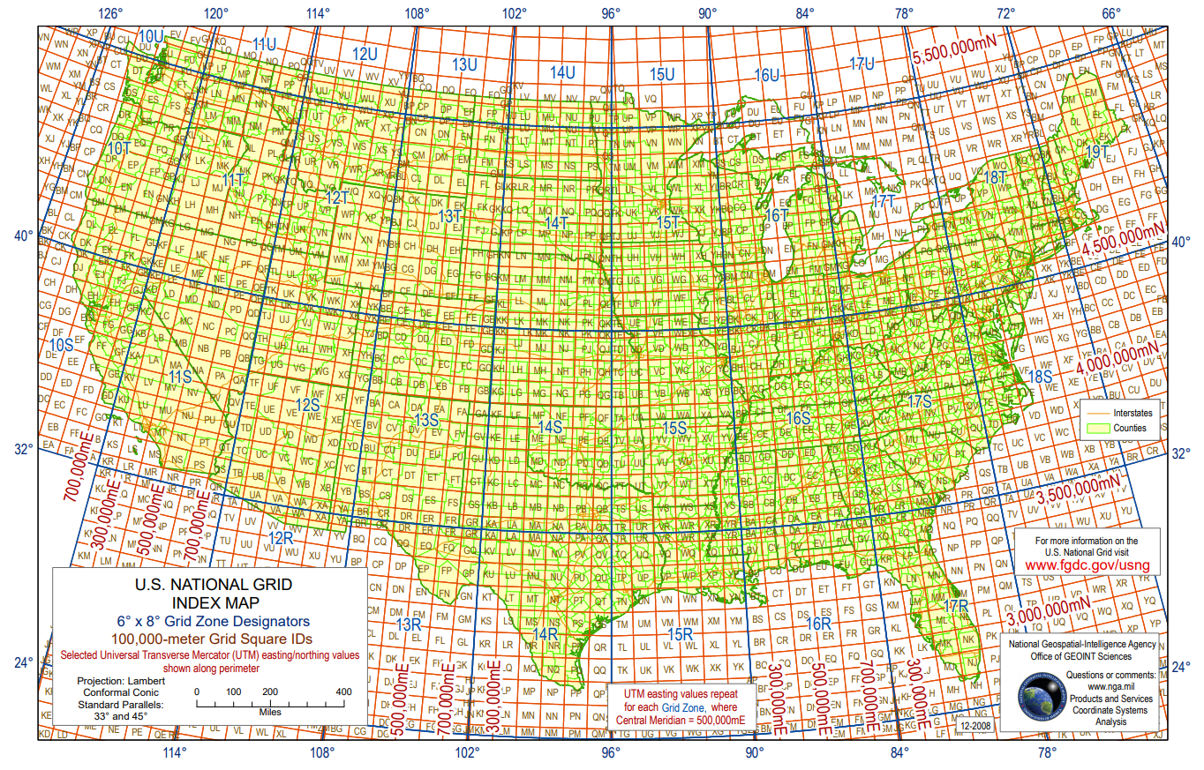
Financial Modeling - USNG Mapping
US National Grid Coordinates
FEMA uses USNG coordinates for regional estimates
Heierarchical rectuangular system which roughly follows lon/lat lines
14 chars based on UTM and MGRS
No available geocoding service for Python
[5]
USNG coordiantes

Slide 17
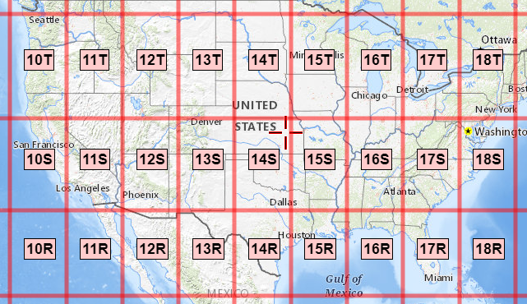
Financial Modeling - USNG Mapping
US National Grid Coordinates
15S .....................precision level 6° × 8°
15S WV ...................precision level 100 km
15S WV 8 6 ...............precision level 10 km
15S WV 83 68 .............precision level 1 km
15S WV 832 683...........precision level 100m
15S WV 8320 6830.........precision level 10m
15S WV 83200 68300 .......precision level 1m
[6]
UTM
zone
easting
northing
USNG coordiantes
main
group

Slide 18
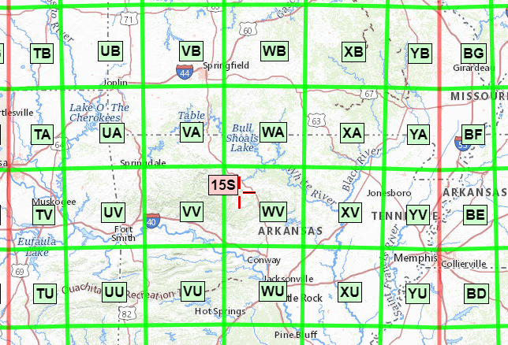
Financial Modeling - USNG Mapping
US National Grid Coordinates
15S .....................precision level 6° × 8°
15S WV ...................precision level 100 km
15S WV 8 6 ...............precision level 10 km
15S WV 83 68 .............precision level 1 km
15S WV 832 683...........precision level 100m
15S WV 8320 6830.........precision level 10m
15S WV 83200 68300 .......precision level 1m
[6]
UTM
zone
easting
northing
USNG coordiantes
main
group

Slide 19
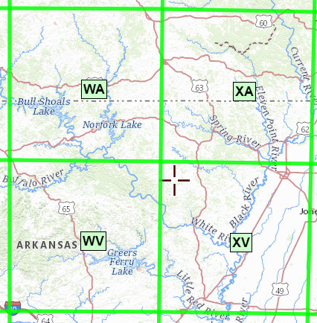
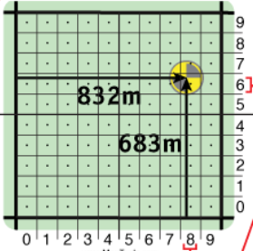
Financial Modeling - USNG Mapping
US National Grid Coordinates
15S .....................precision level 6° × 8°
15S WV ...................precision level 100 km
15S WV 8 6 ...............precision level 10 km
15S WV 83 68 .............precision level 1 km
15S WV 832 683...........precision level 100m
15S WV 8320 6830.........precision level 10m
15S WV 83200 68300 .......precision level 1m
[6]
GZD
easting
northing
USNG coordiantes
main
group
Notes:
Grid Zone Designation

Slide 20
Financial Modeling - USNG Mapping
US National Grid Coordinates
15S .....................precision level 6° × 8°
15S WV ...................precision level 100 km
15S WV 8 6 ...............precision level 10 km
15S WV 83 68 .............precision level 1 km
15S WV 832 683...........precision level 100m
15S WV 8320 6830.........precision level 10m
15S WV 83200 68300
[6]
GZD
easting
northing
USNG coordiantes
main
group
Notes:
Grid Zone Designation

Slide 21
Financial Modeling - USNG Mapping
USNG Mapping Function
Python package mgrs to convert lat/lon to cell and vice versa
Backwards gives cell SW corner lat/lon
Need polygons for each grid of any precision...
WA
XA
“15SWV”
WV
XV
(lat/lon)
(lat/lon)
USNG coordiantes

Slide 22
Financial Modeling - USNG Mapping
“15SWA”
“15SXA”
USNG Mapping Function
Main groups have a general pattern
first letter A-Z (without I and O) west-east
second letter A-V (without I and O) south-north
Use 4 adjacent cells to get full polygon
WA
XA
(lat/lon)
(lat/lon)
WV
XV
“15SWV”
“15SXV”
(lat/lon)
(lat/lon)
USNG coordiantes
Notes:
A-Z

Slide 23
Financial Modeling - USNG Mapping
USNG Mapping Function
Number are easier:
Add 1 to easting/northing
Ex: 15SWV 83200 50000
-> SE - 15SWV 83201 50000
-> NW - 15SWV 83200 50001
-> NE - 15SWV 83201 50001
(00,01)
(01,01)
(00,00)
(01,00)
USNG coordiantes
Notes:
A-Z

Slide 24
Financial Modeling - USNG Mapping
USNG Mapping Function
Few edge cases:
(00,00)
(01,00)
Ex: 15SWV 83200 99999
-> SE - 15SWV 83201 99999 (normal)
-> NW - 15SWA 83200 00000 (edge)
(00,99)
(01,99)
UTM zone changes:
-> main group easting break pattern every 6° lon
-> some main groups only within certain latitudes
USNG coordiantes

Slide 25
Financial Modeling
Xview2 USNG Visualization

Slide 26
Financial Modeling - Xview2 Mapping
Financial Model
Mapped zip-code for all xview2 data based on buildings lat/lon centroids
Pulled Zillow data for a price/sqft for each zipcode from 2018 and averaged missing data
Validated model against county level data obtained from NOAA for a few trusted counties (same order of magnitude accuracy)
Proof of concept
damage level factor
0 no damage
0.5 minor
0.8 major
1 destroyed
Financial Cost Model:
$/sqft/zipcode * sqft * 2floors * damage level factor

Slide 27
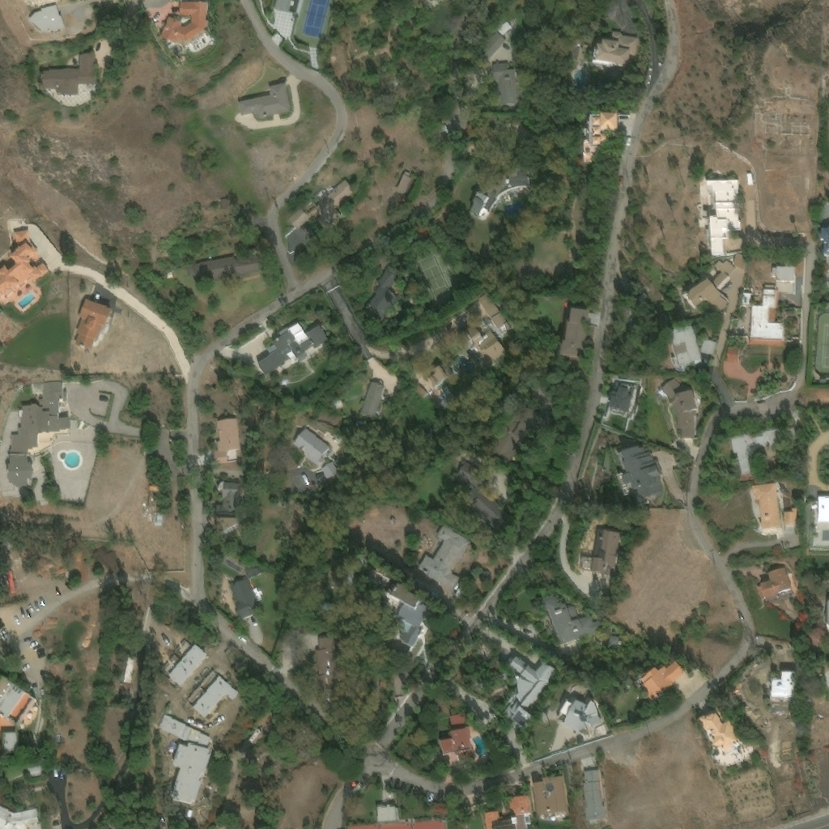
Solution Models - Financial Modeling
(X,Y)
Xview-2 Image Lat/Lon
Xview2 data provides only lon/lat for each building - not image as a whole
lat/lon position is needed for conversion from model -> lat/lon -> USNG coords
All xview2 (x,y) are w.r.t. NW corner
Used building lat/lons to get
Δlatitude/pixel
Δlongitude/pixel
corner lon/lat
(longitude, latitude)

Slide 28
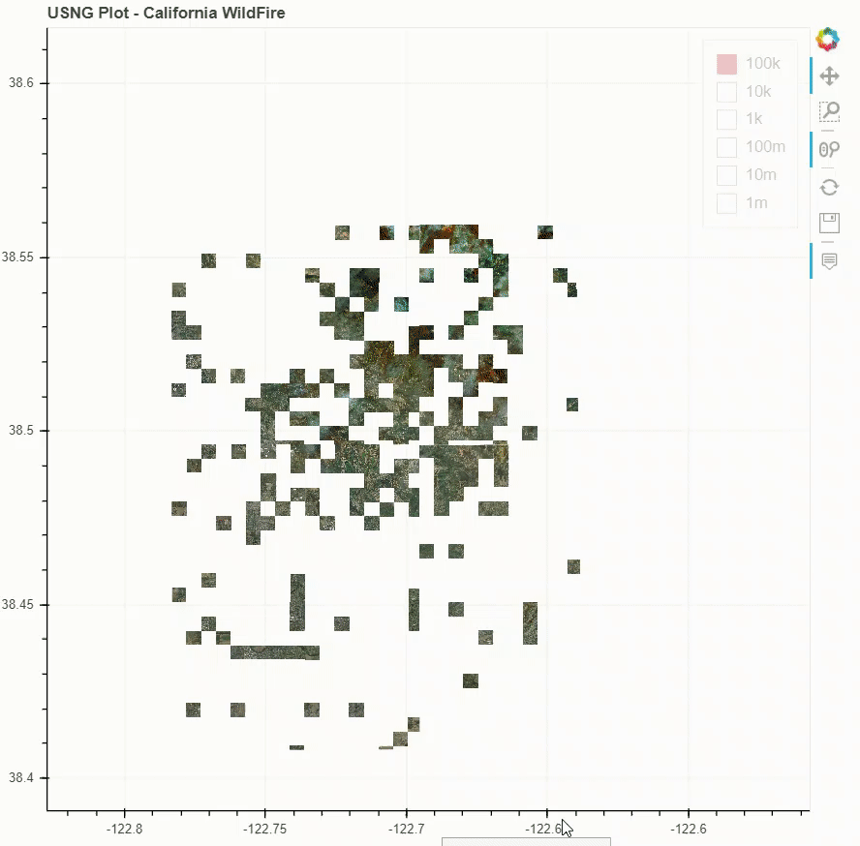
Financial Modeling - Xview2 Mapping
USNG Large Scale Visualization
https://ermlickw.github.io/
Uses centroids, areas, and damage labels of each xview2 building
Financial cost summed over each UNSG grid over all precisions
Methods used in application
Financial cost estimation using USNG coordinates

Slide 29
Xview2 Modeling
Connected UNets

Slide 30
Solution Models - Final Report
Keras Model Pipeline
Image masks are created
Use polygons from json files to draw building outlines in an array
Result is a (1024, 1024) shaped array where each pixel is a class
0: No Building, 1: No Damage, 2: Minor Damage, 3: Major Damage, 4: Destroyed
Keras data loader is created
At each iteration, pre image, post image, and mask are loaded from the training data
Prevents all images from being loaded into memory at once
Model is trained on these images

Slide 31
Solution Models - Final Report
Keras Model Pipeline continued
The model is validated
At each epoch, a random subset of the training data was used for validation
Due to the limited training data, being able to use all for training was key
Best model weights are saved
Inference is performed
Iterate over test images and return pixel-by-pixel predictions for each class
Output is a softmax function and each array is shape (1024, 1024, num_classes)
Take the argmax over the classes to reshape to (1024, 1024)
This is fed into the metrics script, and F1 scores are returned

Slide 32
Solution Models - Final Report
U-Net Model
U-Net models have had success in image segmentation problems
Created a dual-input U-Net model using Keras and TensorFlow
Needed a way to use both pre and post disaster images
Images are encoded differently, but share the same weights
The image differences are taken into account during the decoder stage
Used a combination of Weighted Cross Entropy and Dice Loss
RMSProp loss function
Adjusted class weights and learning rate throughout training
augmentations were not effective

Slide 33
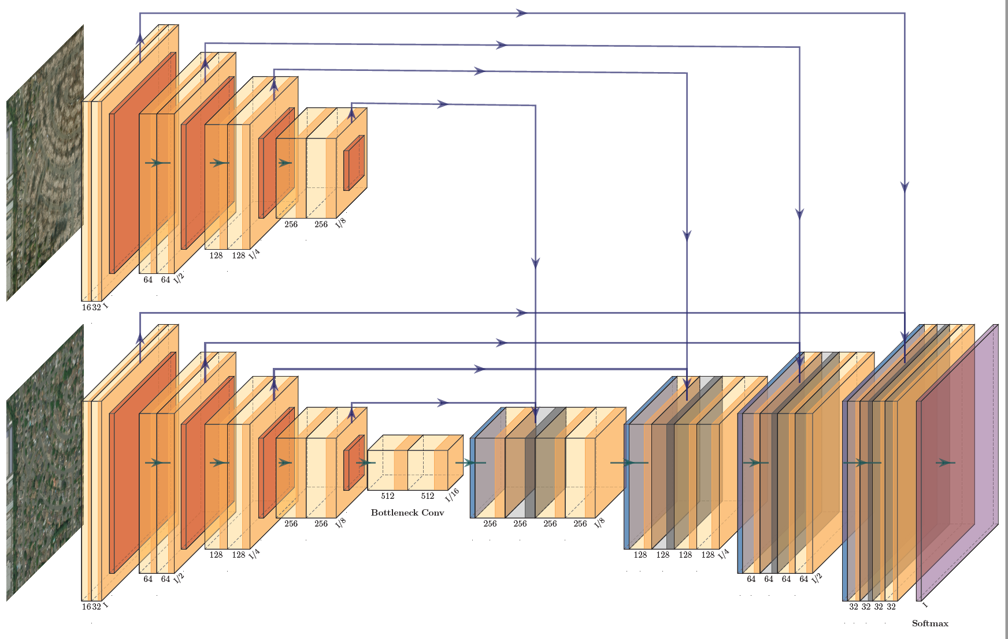
Solution Models - Final Report

Slide 34
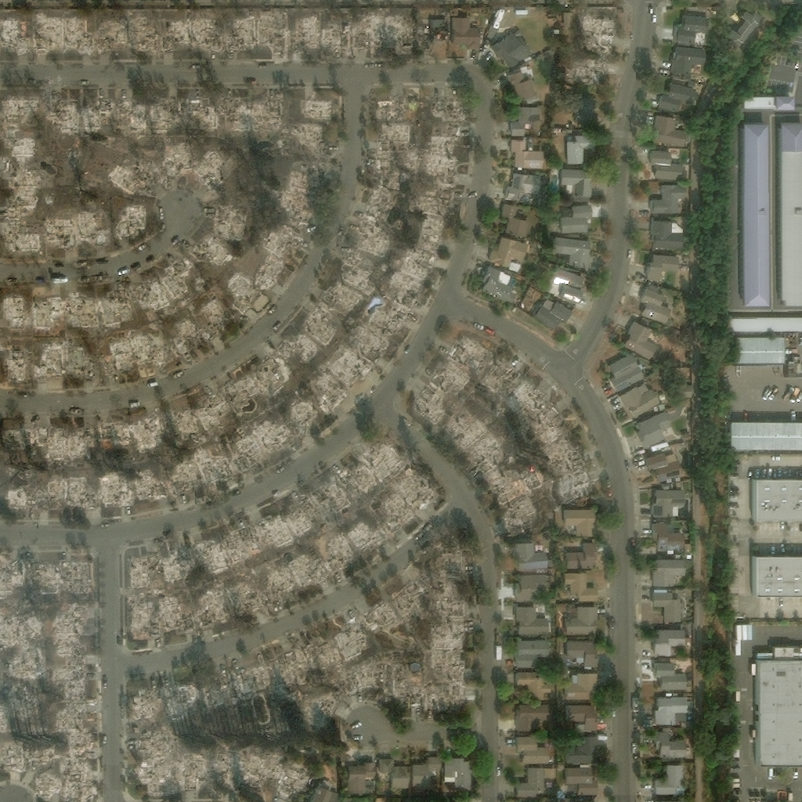
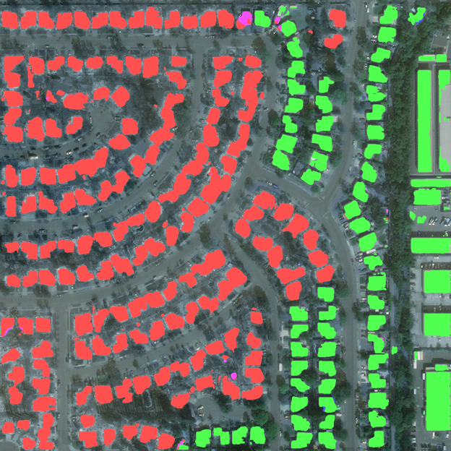
Santa Rosa Wildfire - Post Disaster

Slide 35
Xview2 Modeling
Mask RCNN

Slide 36
Analytics & Algorithms -Localization&Damage Assessment
Here we have used open-source library that implements Mask RCNN on top of TensorFlow/Keras.
It is a simple model that combines two extremely powerful existing models together - Faster R-CNN and semantic segmentation. Two Main components of this model are RPN and RoIAlign Layer
Region Proposal Network (RPN)is able to look at the feature map and get a set of bounding boxes that would essentially have an object of relevance by using selective search
RoIAlign Layer helps with pixel-level segmentation and uses bilinear interpolation to avoid mis alignments

Slide 37
Analytics & Algorithms- Damage Assessment
Mask RCNN approach for Damage Detection in keras.
Combine pre - post images to get 6-channel input image.
Use Pretrained weights from the localization model.
Update Classes to - 0 : No-damage 1: Minor-damage 2: Major-damage 3: Destroyed and BG
Supercategory: Building
3 Architecture remains same with Hyper - Parameter Tuning.
Learning rate
RPN anchor scale : This adjusts pixel level for detection of Region proposals.
Detection threshold: This adjusts the detection threshold to give room to false positives when the objects detected are much smaller
non-maximum suppression : It groups highly overlapped detection into one class to avoid duplication.

Slide 38
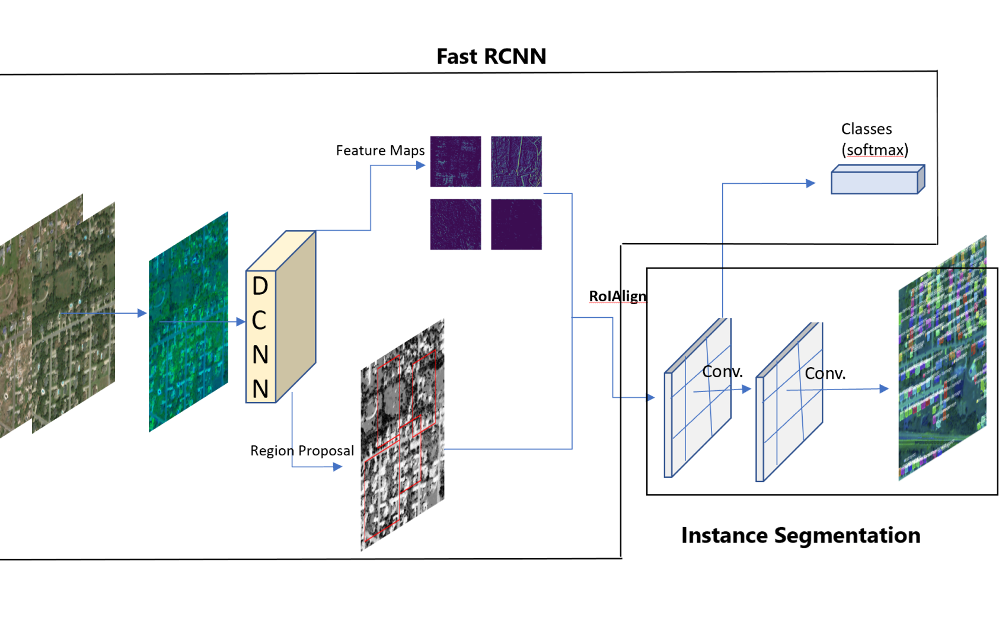
Analytics & Algorithms -Damage Assessment

Slide 39
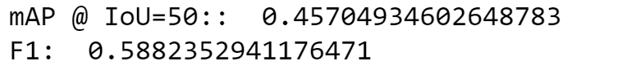
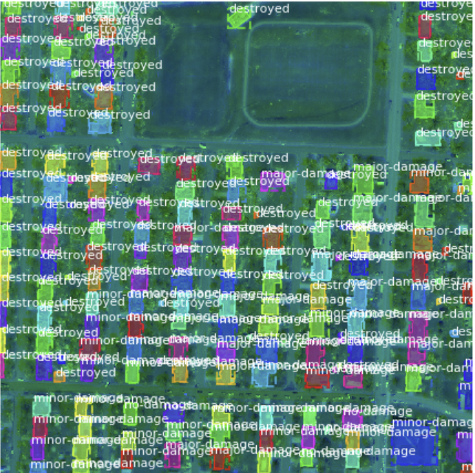
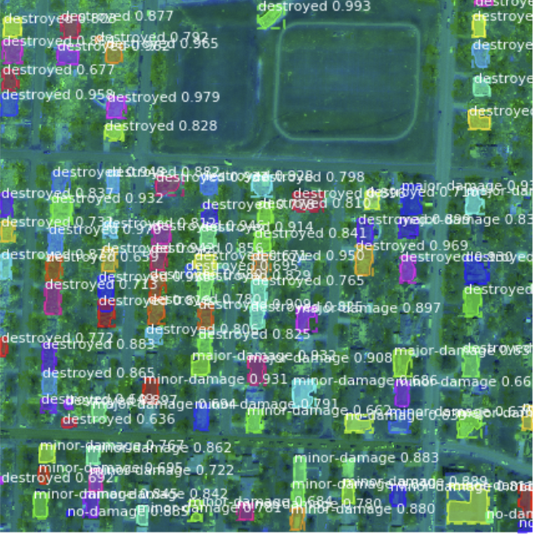
Ground Truth
After Detection

Slide 40
Application

Slide 41
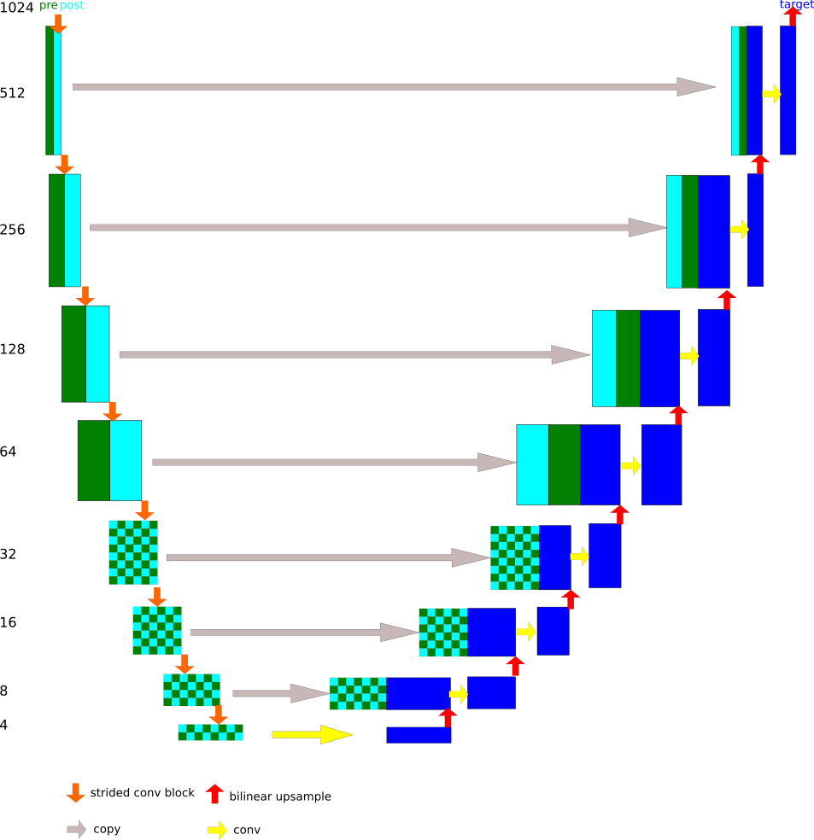
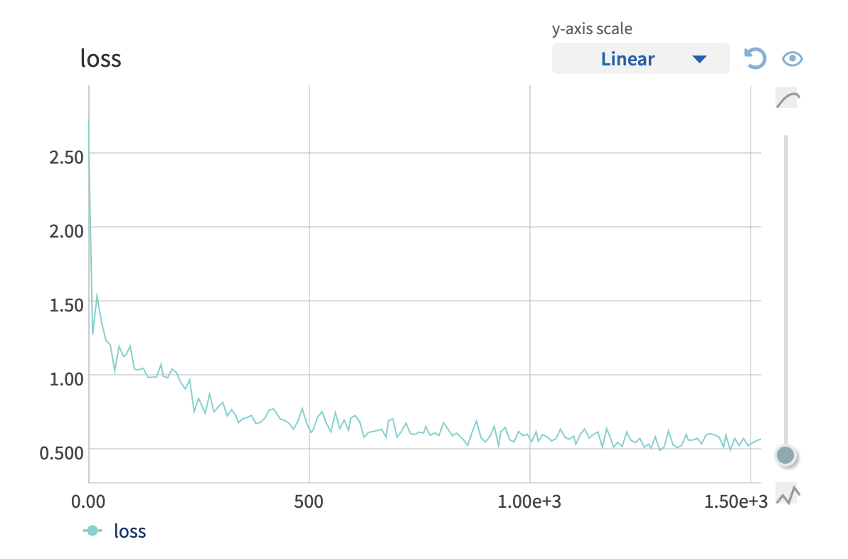
Application
Modified U-Net with Paired Image Inputs
To establish an MVP — and use inference outputs to validate the financial modeling approach — we applied two, relatively simple, open source U-Nets with near-top-50 weighted score (0.68)
6–8 GPUs leveraged, both models trained overnight
Modified U-Nets with EfficientNet encoder blocks
~5 seconds for inference per image
Damage classification is done at the pixel level (as opposed to the building level) with the localization applied as a “mask”

Slide 42
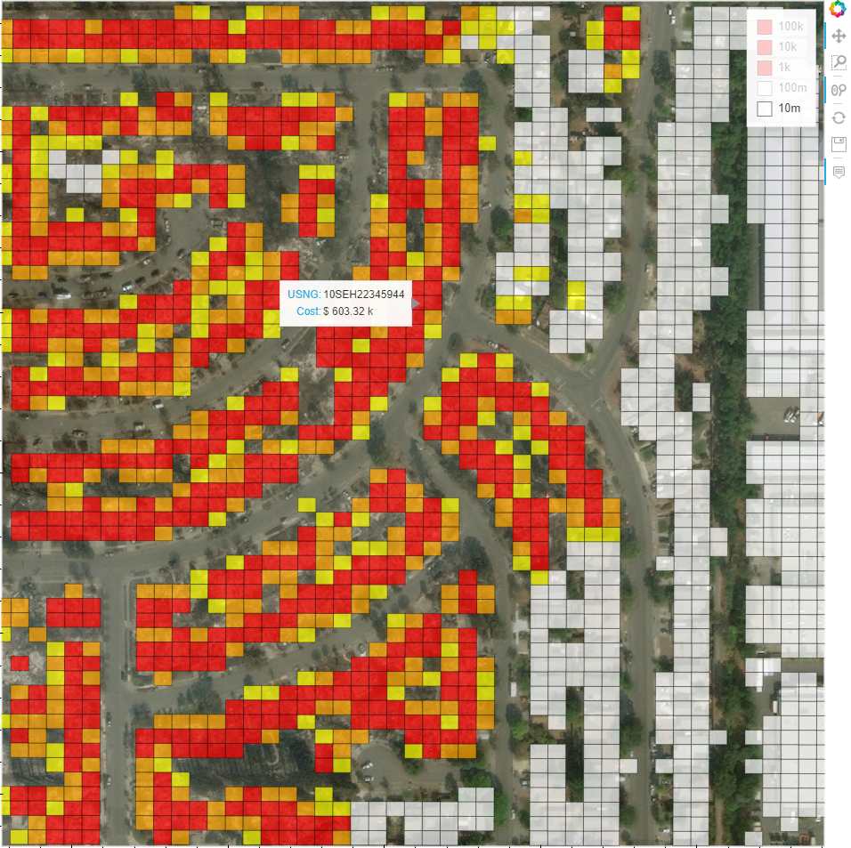
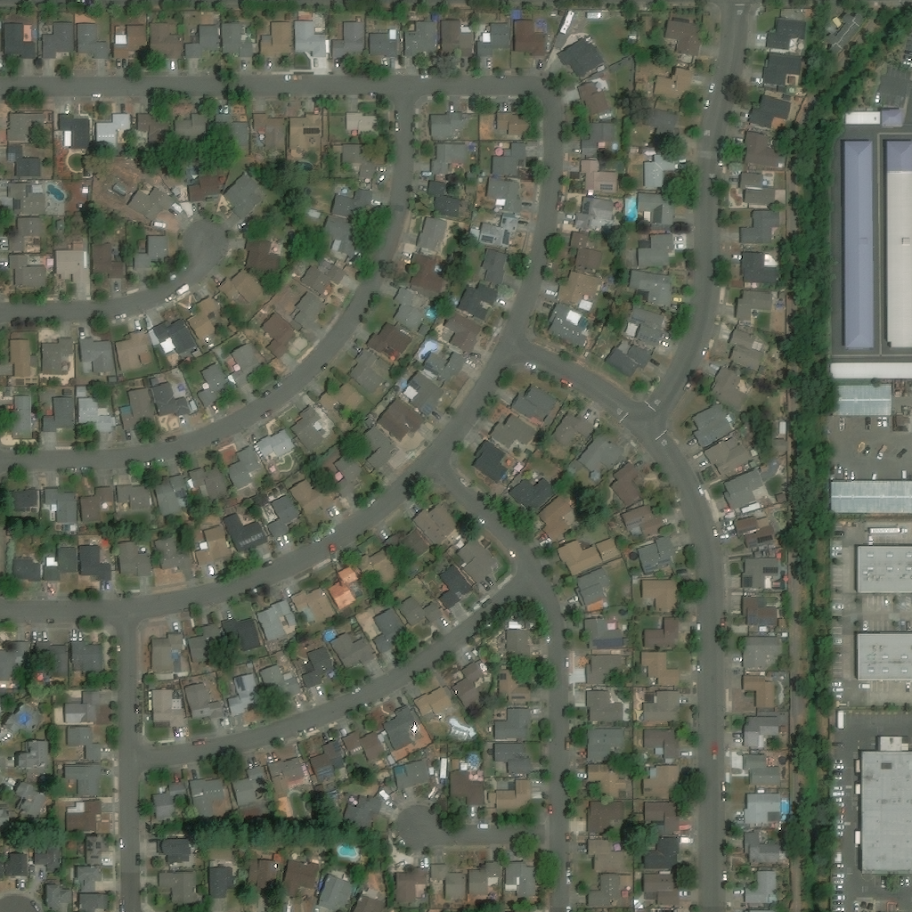
Application
Model
Overview
User inputs
before and after image
lat/lon of NW and SE corners

Slide 43
Application
Workflow
inputs
Before and after image
NE and SW corner lat/lons
methods (should be ~15 seconds)
run building localization and damage assessment and output pixel map (5~sec)
convert building masks to polygons
divide polygons into smaller polygons (to ensure all USNG grids are represented)
find centroids of polygons in lat/lon
find MGRS grids coords for each centroid lat/lon using our in-house function
convert MGRS grid coords to image coordiantes
sum pixel values within each MGRS grid multiplied by sqft/pixel and $/sqft based on zip code
outputs
display image with USNG overlaid with aggregate cost

Slide 44
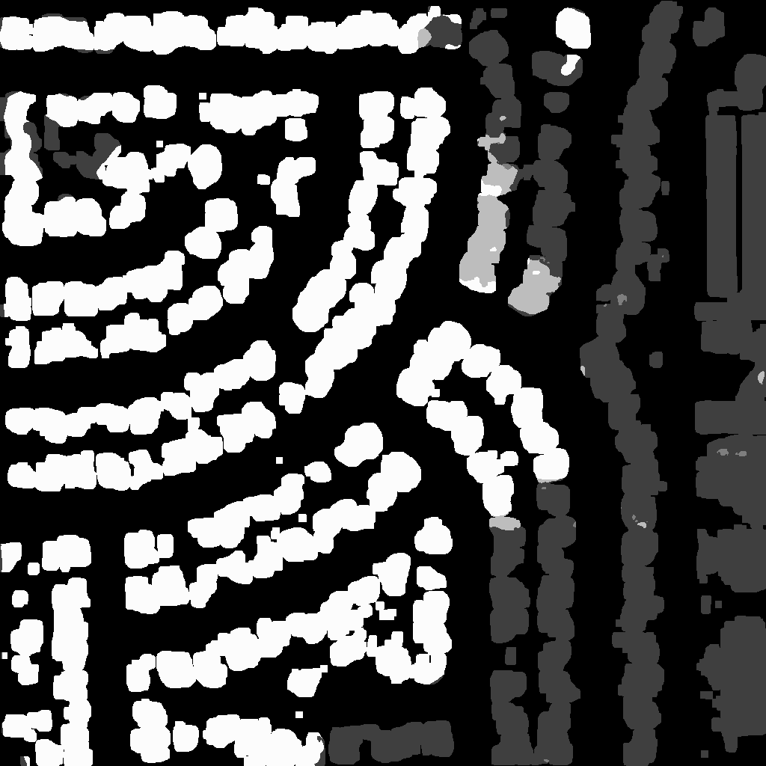
Application
Damage Classification Model
Methods
User inputs
before and after image
lat/lon of NW and SE corners

Slide 45
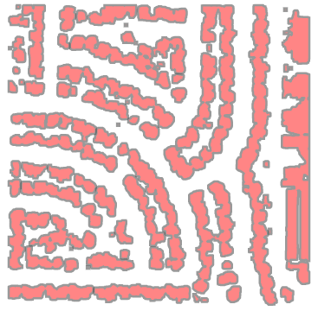
Application
(X,Y)
Polygon Conversion and Image lat/lon Transform
Determine building polygons using contour function
translate
&
scale
Convert pixel coordiantes to lat/lon
Δlat/pix and Δlon/pix
(longitude, latitude)
Damage Classification Model

Slide 46
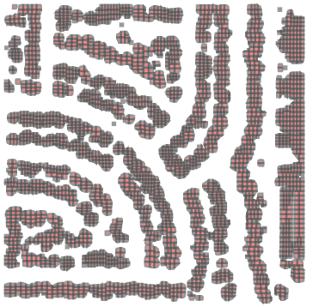
Application
Polygon Division
Divide large polygons (model incorrectly combines buildings)
Determine centroid of each polygon (USNG all accounted for)

Slide 47
Application
Determine list of unique USNG grids from centroids
Get polygons of USNG grids using our in house function (all precisions)
Get USNG polygons
Centroids
mgrs python package
USNG list
Our USNG Mapper Package
USNG polygons

Slide 48
Application
Get cost for each USNG
Get zipcode from lat/lon and $/sqft from Zillow data
Backconvert USNG lat/lons to image (x,y) coordinates
Input lat/lon
Zipcode
$/sqft from Zillow
(X,Y)
translate
&
scale
USNG polygons in image coordinates
USNG polygons
(longitude, latitude)

Slide 49
Application
damage level factor
0 no damage
0.5 minor
0.8 major
1 destroyed
Get cost for each USNG
Find sqft per pixel - area of image / resolution
Change pixel values to financial model damage levels
USNG polygons in image coordinates
$/sqft from Zillow
For all pixels in a polygon, multiply:
*
Fiscal cost for each USNG
pixel damage values for each USNG
*
sqft/pixel

Slide 50
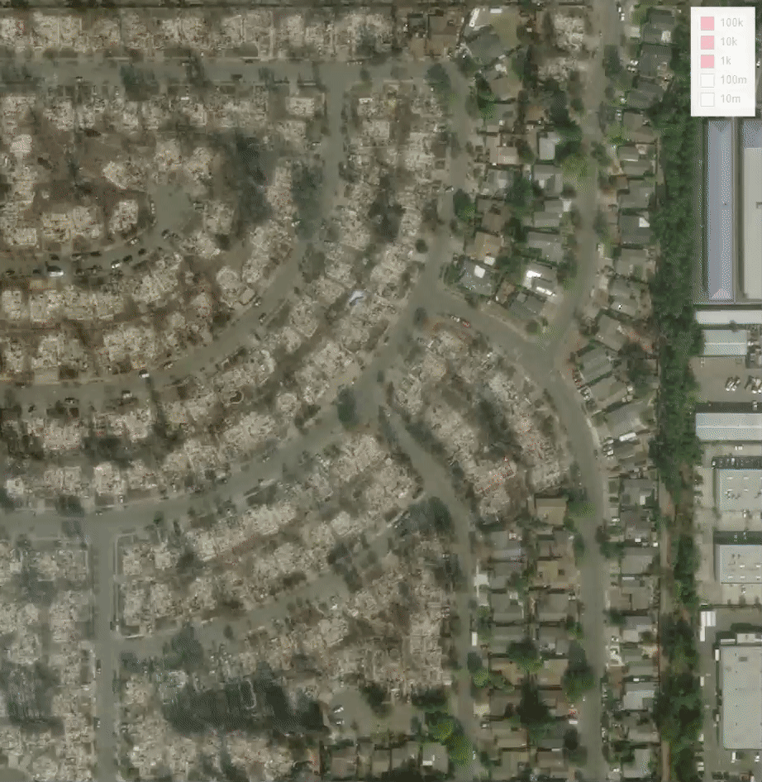
Application
Financial Model -- Flask Application Pipeline
Around 5 seconds for pixel level building localization & damage classificaiton
Less than 15 seconds for financial analysis
Accurate financial estimates to 10 meter precision (1m is possible but computationally expensive and GSD is >1m)

Slide 51
Contibutions
USNG Mapping Function
Connected U-Net Model
Mask R-CNN Model
Proof of Concept Application http://test-env.eba-6qua3x4j.us-east-1.elasticbeanstalk.com/

Slide 52
Lessons Learned
Large images and dense networks are not a good combination
The computation power needed to run models was significant
Multiprocessing on GPUs didn’t always offer significant speed gains
Used vectorization where possible, to improve performance
The U-Net struggled on classifying minor and major damage
There is not a clear delineation between the classes
The classes are significantly imbalanced
Oversampled minor and major damage
Gave these classes more weight with the loss function
Mask RCNN is not a ideal model for satellite images due to the sheer detailed objects in the images
It is still a good model for experimenting with dataset and with minor tweaks in the architecture can get better at detecting satellite image objects due to its simplicity.

Slide 53
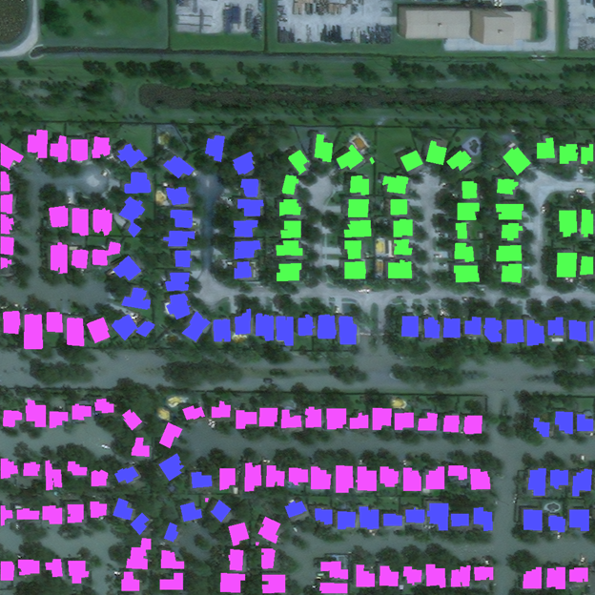
Example Flooding Image
Some of the flooded buildings are classified as major damage and some are classified as minor damage
Green = No Damage
Blue = Minor
Purple = Major
Hard for humans to tell the difference

Slide 54
Future Work
More accurate pixel-based financial model if claims data can be obtained
Flooding around buildings was difficult to classify
Hard to see on the images for humans
Model had the most trouble classifying these instances
Experiment with different U-Net encoder blocks
VGG, Inception, ResNet, etc.
Use Quadratic Weighted Kappa as a loss function
The model blends together some predicitons (i.e. no damage and major)
Places higher penalty on classes that are further away from the actual
Improve Mask RCNN further by combining pre post images during segmentation phase and implement weighted cross entropy loss.

Slide 55
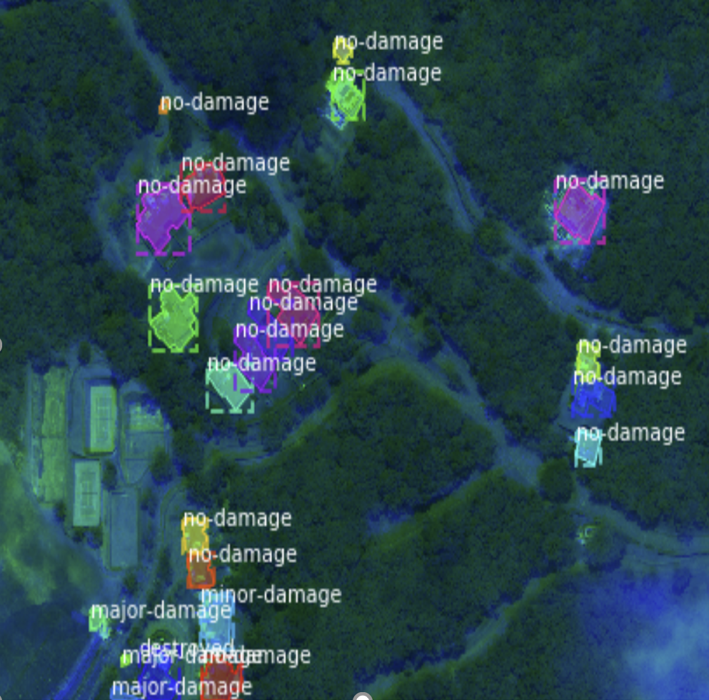
Questions

Slide 56
References
https://www.fema.gov/news-release/2017/09/07/fact-sheet-what-expect-when-you-register-fema-disaster-assistance
https://www.fema.gov/pdf/library/remotes.pdf
https://xview2.org/ & https://arxiv.org/pdf/1911.09296.pdf
https://keisan.casio.com/exec/system/1224682277
https://legallandconverter.com/p50.html
https://mappingsupport.com/p2/coordinates-usng-gissurfer-maps.html

Slide 57
APPENDIX SLIDES

Slide 58
APPENDIX SLIDES

Slide 59
APPENDIX SLIDES

Slide 60
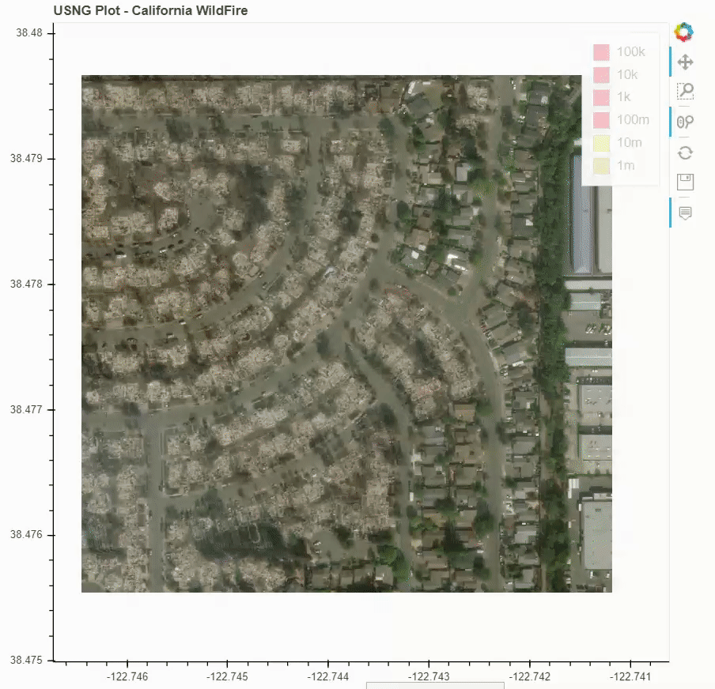
Application
Financial Model -- Flask Application Pipeline
Around 5 seconds for pixel level building localization & damage classificaiton
~7 seconds for financial analysis
Accurate financial estimates to 10 meter precision (1m is possible but computationally expensive and GSD is >1m)
http://test-env.eba-6qua3x4j.us-east-1.elasticbeanstalk.com/

Slide 61
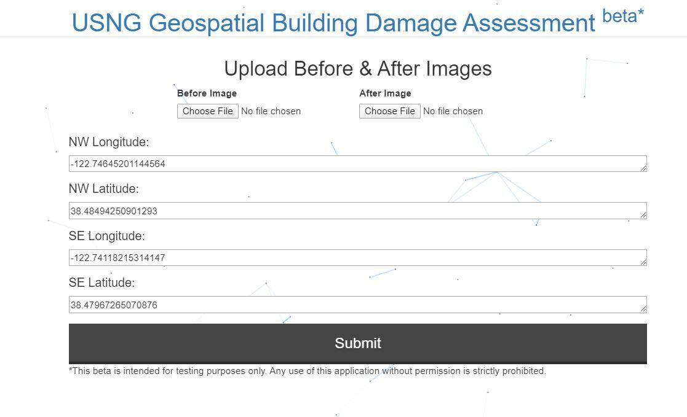
Application

Slide 62
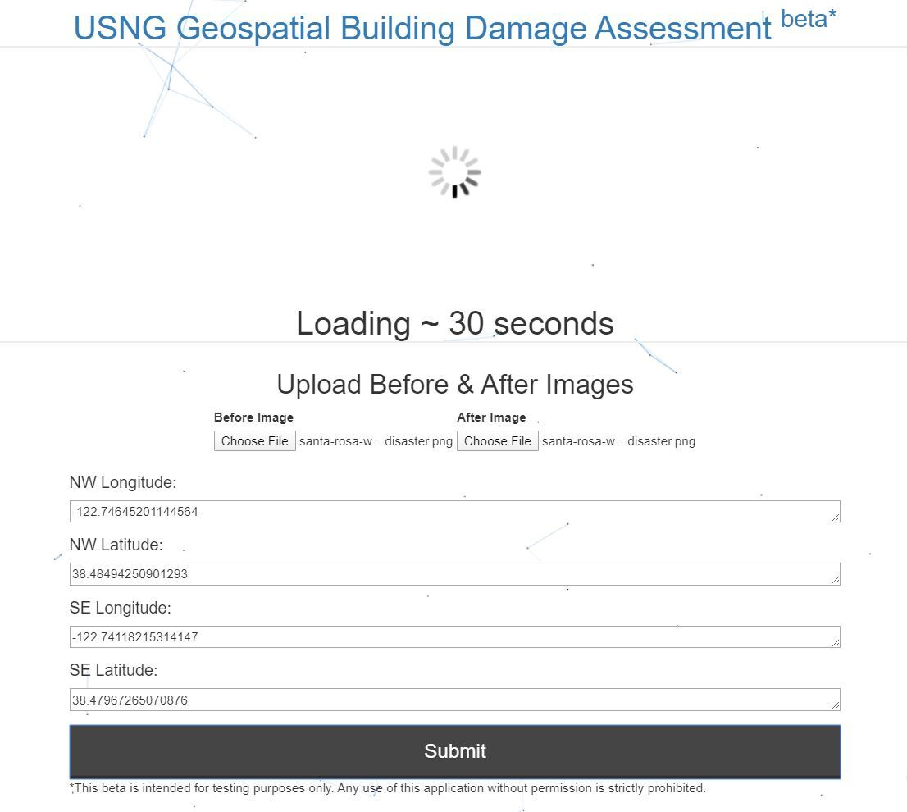
Application

Slide 63
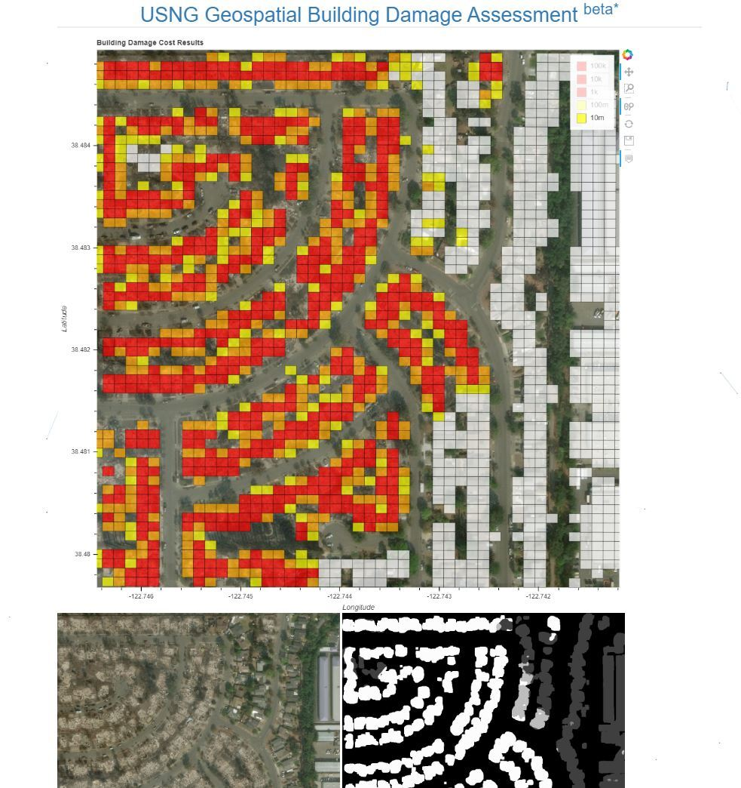
Application

Slide 64
Solution Models - Final Report
Keras Model Pipeline
Image masks are created
Use polygons from json files to draw building outlines in an array
Result is a (1024, 1024) shaped array where each pixel is a class
0: No Building, 1: No Damage, 2: Minor Damage, 3: Major Damage, 4: Destroyed
Keras data loader is created
At each iteration, pre image, post image, and mask are loaded from the training data
Prevents all images from being loaded into memory at once
Model is trained on these images

Slide 65
Solution Models - Final Report
Keras Model Pipeline continued
The model is validated
At each epoch, a random subset of the training data was used for validation
Due to the limited training data, being able to use all for training was key
Best model weights are saved
Inference is performed
Iterate over test images and return pixel-by-pixel predictions for each class
Output is a softmax function and each array is shape (1024, 1024, num_classes)
Take the argmax over the classes to reshape to (1024, 1024z0
This is fed into the metrics script, and F1 scores are returned

Slide 66
Solution Models - Final Report
Baseline Model
Used a baseline model provided with the competition
Localization: spacenet building segmentation model
Classification: simple CNN architecture
Results were effective for localization, but poor for classification
Method was also too slow to implement in an application
Needed a model that simulataneously performs classification and prediction

Slide 67
Solution Models - Final Report
U-Net Model
U-Net models have had success in image segmentation problems
Created a dual-input U-Net model
Needed a way to use both pre and post disaster images
Images are encoded differently, but share the same weights
The image differences are taken into account during the decoder stage
Used a combination of Weighted Cross Entropy and Dice Loss
RMSProp loss function
Adjusted class weights and learning rate throughout training
augmentations were not effective

Slide 68
Solution Models - Final Report

Slide 69
Lessons Learned
Large images and dense networks are not a good combination
The computation power needed to run models was significant
Multiprocessing on GPUs didn’t always offer significant speed gains
Used vectorization where possible, to improve performance
The model struggled on classifying minor and major damage
There is not a clear delineation between the classes
The classes are significantly imbalanaced
Oversampled minor and major damage
Gave these classes more weight with the loss function

Slide 70
Future Work
Flooding around buildings was difficult to classify
Hard to see on the images for humans
Model had the most trouble classifying these instances
Experiment with different U-Net encoder blocks
VGG, Inception, ResNet, etc.
Use Quadratic Weighted Kappa as a loss function
The model blends together some predicitons (i.e. no damage and major)
Places higher penalty on classes that are further away from the actual

Slide 71
Santa Rosa Wildfire - Post Disaster

Slide 72
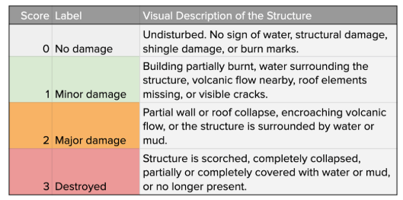
Solution Models - Final Report
Problem areas that were solved
Large images and dense networks are not a good combination
The computation power needed to run models was significant
Multiprocessing on GPUs didn’t always offer significant speed gains
Used vectorization where possible, to improve performance
The model struggled on classifying minor and major damage
There is not a clear delineation between the classes
The classes are significantly imbalanaced
Oversampled minor and major damage
Gave these classes more weight with the loss function

Slide 73
Solution Models - Final Report
Areas to focus on - if given more time
Flooding around buildings was difficult to classify
Hard to see on the images for humans
Inconsistency in classification, minor or major
Model had the most trouble classifying these instances
Experiment with different U-Net encoder blocks
VGG, Inception, ResNet, etc.
Use Quadratic Weighted Kappa as a loss function
The model blends together some predicitons (i.e. no damage and major)
Places higher penalty on classes that are further away from the actual

Slide 74
Solution Models - Updates
Financial Model
Will need to integrate model output into financial model
identify buildings as polygons
squarefootage
centroids
lat/lon conversion
MGRS grids cost summation - could be building level summation or pixel level

Slide 75
Solution Models - Updates
Financial Data
validated results with county level data
updated model is more accurate (same order of magnitude as approximations)
$/sqft/zipcode * sqft * 2floors * damage level factor
where damage level factor
= 0 for no damage, 0.5 minor, 0.8 major, 1 destroyed

Slide 76
Solution Models - Updates
Modified U-Net with Paired Image Inputs
To establish an MVP — and use inference outputs to validate the financial modeling approach — we applied two, relatively simple, open source U-Nets with near-top-50 weighted score (0.68)
6–8 GPUs leveraged, both models trained overnight
Modified U-Nets with EfficientNet encoder blocks
~5 seconds for inference per image
Damage classification is done at the pixel level (as opposed to the building level) with the localization applied as a “mask”

Slide 77
Solution Models - Updates
Financial Data - next steps
Will compare these values with our obtained county level values and see how accurate they are and what needs to be adjusted

Slide 78
Solution Models - Updates
(X,Y)
Xview-2 lat/lon mapping
Xview2 data provides lon/lat for each building but not image as a whole
This lat/lon position is needed for mapping and also for conversion from model -> lat/lon -> USNG coords
We found an algorithm to determine lat/lon of each xview2 image for mapping
We will use this for final flask app as well
(longitude, latitude)

Slide 79
Solution Models - Updates
Financial Data
Mapped zip-code for all xview2 data
Pulled zillow data for a price/sqft for each zipcode
financial cost model is currently
$/sqft/zipcode * sqft * damage level factor
where damage level factor
= 0 for no damage, 0.25 minor, 0.75 major, 1 destroyed

Slide 80
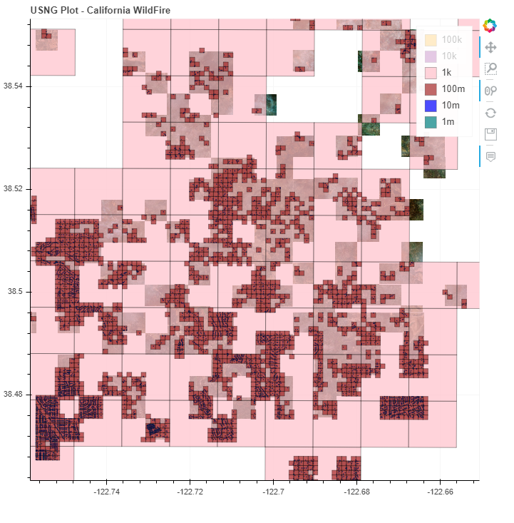
Solution Models - Updates
US National Grid Coordinates Viz
Added xview2 images to Bokeh plot
Color scaled each precision layer by financial cost
Precision layers are hideable
Financial cost estimation using USNG coordinates

Slide 81
Solution Models - Updates
US National Grid Coordinates Viz - next steps
Will need these processes to display images received in app
https://ermlickw.github.io/
Financial cost estimation using USNG coordinates

Slide 82
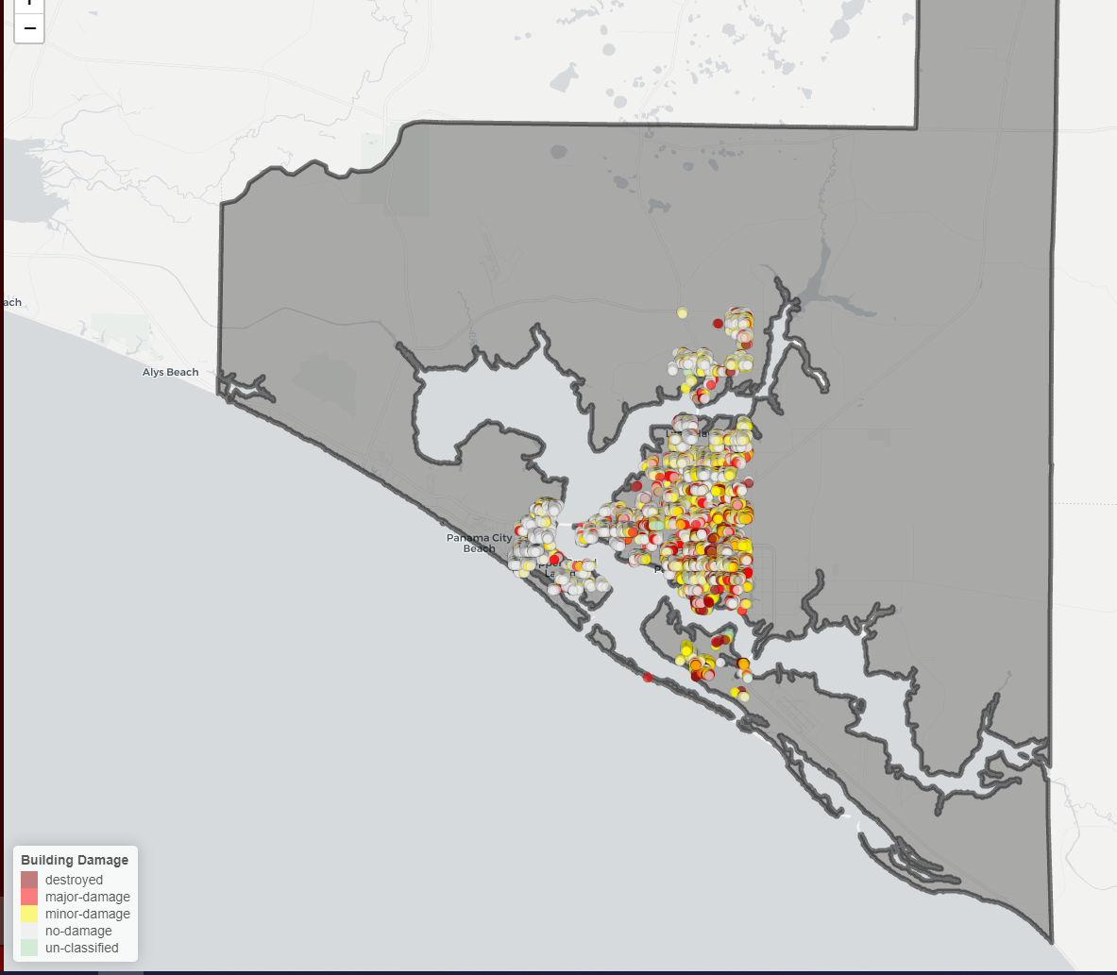
Analytics & Algorithms -Updates
County level visualizations
Noticed damage area is much smaller than county area
Will result in poor estimations
Some disasters in Xview2 (moore, tuscaloosa, joplin tornadoes and Hawaii eruption) may have captured all affected buildings
Focus on these for financial modeling checking only
Hurricane Michael Bay County Xview2

Slide 83
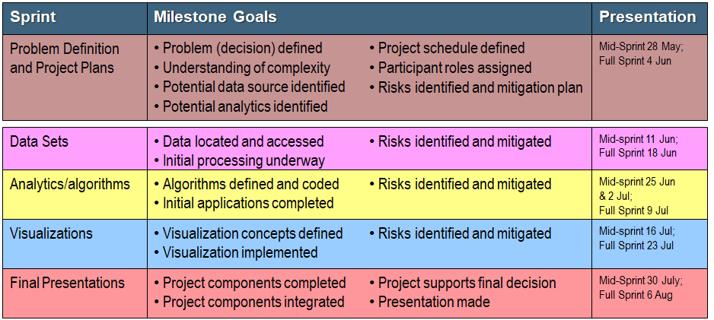
DAEN 690 Schedule

Slide 84
Analytics & Algorithms -Updates
Dataset imbalance & resampling
Imbalanced classes will need to be upsampled or downsampled for each disaster type
Critical for training
Hurricane Michael Bay County and Xview2 Image Data

